Slide 1

Software Testing & Quality (12)
Web Site Testing

Slide 2
Highlight
Web Page Fundamentals
Web site Testing knowledge
Black-Box Testing
Gray-Box Testing
White-Box Testing
Configuration and Compatibility Testing
Usability Testing
Introducing Automation

Slide 3
What is a Web Page?
A web page comprises:
  A layout
  A framework of instructions
  Links to related files
  Content (words, graphics, sounds, media)
In other words: A lot of files!
  The main file is the .htm file (default.asp, .php, …) - this is the framework which holds the codes, links, and content
  Each graphic (both nice pictures or a simple line) is a file called up by the .htm file
  Each link connects to another file

Slide 4
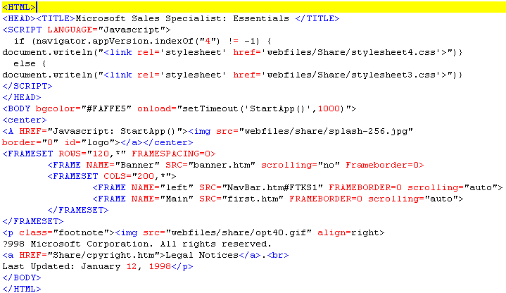
Example

Slide 5
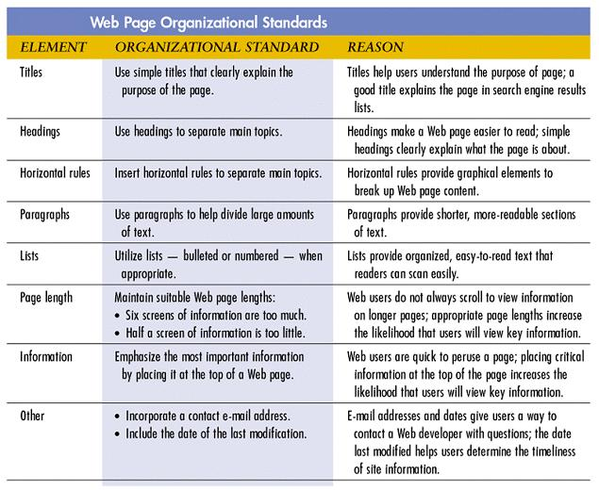
Web Page Organization Standards

Slide 6
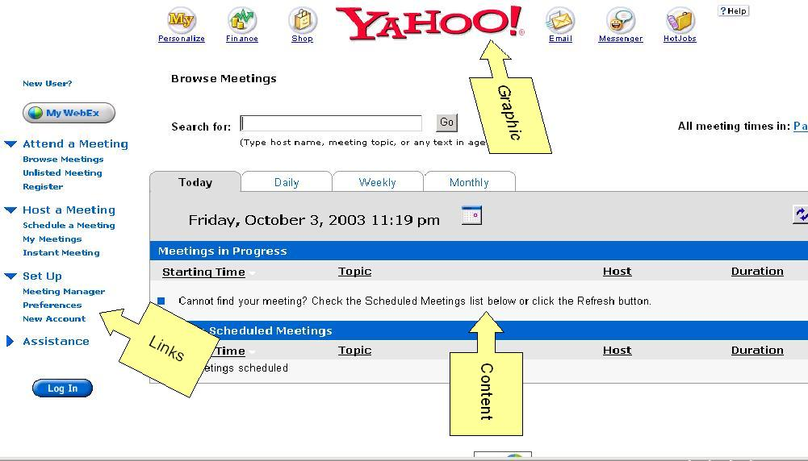
Web Page Fundamentals-Example
Input data
field
Yahoo.WebEx.Com
Button

Slide 7
Web Site Testing
Web page content
  Content text, and spelling
  Different sizes, fonts, colors, …
  Graphics, photos, UI
Functionality
  Links, Buttons, Navigate bar, …
  Log in/Log out, Cookie, Session, …
  Logic, …, Various operation
Usability
Security
Performance

Slide 8
Technologies in Web page
HTML/DHTML/XML
JavaScript, Java
VBScript
ActiveX, Plug-in
Perl, CGI
PHP/ASP/JSP

Slide 9
Black-Box Testing
Text, ATL text (Alternate)
Hyperlinks
Graphics
Forms
Objects and other Simple Miscellaneous Functionality

Slide 10
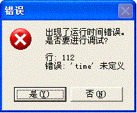
Gray-Box Testing
Gray-Box Testing (or translucent-box), it is the effective combination of black box (external) and white box (internal or unit) testing
Test the software as a black-box, but you supplement the work by taking a peek( not a full look, as in white-box testing) at what makes the software work
var lmonth=months[time.getMonth() + 1];

Slide 11
White-Box Testing
Precondition:
  Need have some knowledge of the Web site’s system structure;
  Need have some knowledge of programming
Then:
  Dynamic Content
  Database Driven Web pages
  Programmatically Created Web Pages
  Server performance and Loading
  Security

Slide 12
Compatibility Testing
Is performed to ensure that a site performs as intended across multiple operating system and browser configurations
Ensure certain coding such as Active X, Java, Javascript and CGI, function properly across multiple configurations

Slide 13
Configuration and Compatibility Testing
Hardware platform
  Multiple Operating Systems
  Multiple Browser Compatibility: IE 4.0, IE 5.0, IE 6.0, NS 4.5, NS 4.7, NS 6.0
  Connection Speed: Dial 64K, ADSL, T1 or LAN
  Browser Options: Disable ActiveX in IE, plug-Ins
  Java Machine Versions in Mac OS 9/OS X
  SSL w/t proxy, SSL w/o proxy
  Monitor Resolution, Scrolling, Text size
Compatibility Testing
  Forward Compatibility
  Backward Compatibility

Slide 14
Network Testing
Tests need to be run to ensure that a product is networkable
The product should also be tested to make sure it can be run on several network OS environments
Also stress tests is needed to ensure that a minimum number of users can use an application at one time

Slide 15
Usability Testing
Ease-of-Use | vs. | Visual Virtuosity
Buttons are buttons |  | Splash Page
Menus are menus |  | Matt-pastel colours
Breadcrumb trails |  | (Flash) graphics, (Shockwave/Real) sounds, (Quicktime) movies
Clear compatible colours |  | Unusual designs
Stick to Web-Norms

Slide 16
Top Ten mistakes in Web Design
1. Gratuitous Use of Bleeding-Edge Technology
2. Scrolling Text, marquees and Constantly Running Animations
3. Long Scrolling Pages
4. Non-Standard Link Colors
5. Outdated Information
6. Overly long Download Times
7. Lack of navigation Support
8. Orphan Pages
9. Complex Web Site Addresses (URLs)
10. Using Frames

Slide 17
Practice in Web Design
Page Width
Colors
Typeface
Page Length/Scrolling
Navigation (bars, buttons, image maps)
Page Names (description)

Slide 18
Introducing Automation
Organization of Web Test Tools Listing
  Load and Performance Test Tools
  Java Test Tools
  Link Checkers
  HTML Validators
  Free On-the-Web HTML Validators and Link Checkers
  PERL and C Programs for Validating and Checking
  Web Functional/Regression Test Tools
  Web Site Security Test Tools
  External Site Monitoring Services
  Web Site Management Tools
  Log Analysis Tools
  Other Web Test Tools

Slide 19
Rational Site Check
Internet and intranet website testing
Checks for broken links, structure etc
Can deploy website to target destination using Site check

Slide 20
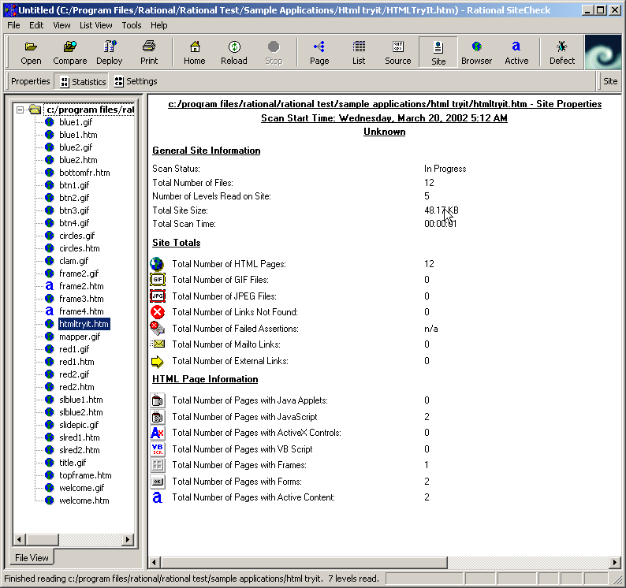
Example

Slide 21
GUI Record and Playback
Capture the keystrokes, input, and responses as tests being run, and compare expected with actual outcome; Generate script records when capturing
  Microsoft: Visual Test Suite
  Rational: Visual Test and TeamTest
  Mercury Interactive: XRunner, WinRunner
  Compuware Corporation: QARun
  WinRunner
    http://www-svca.mercuryinteractive.com/products/winrunner/
  SilkTest
    http://www.segue.com/html/s_solutions/s_silktest/s_silktest_toc.htm
  Robot
    http://www.rational.com/products/robot/index.jsp?SMSESSION=NO

Slide 22
Script example
web_browser_invoke(IE, "http://192.168.167.240/mc2/");
wait(2);
# menu
set_window("menu",124);
web_image_click("hostameeting2", 32, 7);
web_image_click("ScheduleMeeting2", 30, 4);
# main
set_window("main",5);
edit_set("userName","test");
password_edit_set("password","9c28757eca2b3741");
button_press("Log In");
web_sync(8);
edit_set("ConfName","WebEx Test");
button_press("Start Meeting");
……
while(win_exists("WebEx Meeting Manager - WebEx Test", 20) != E_OK){
wait(2); }
#set_window ("WebEx Meeting Manager - WebEx Test", 30);

Slide 23
Load Test
The purpose is to simulate thousands of users concurrently visiting and interacting with web site
There are Tools such as WebLoad that allows tester to provide different scripts to simulates the stress/load testing
  Indicates where problems are occurring
  Indicates how many concurrent users your site can handle before response times become unacceptable

Slide 24
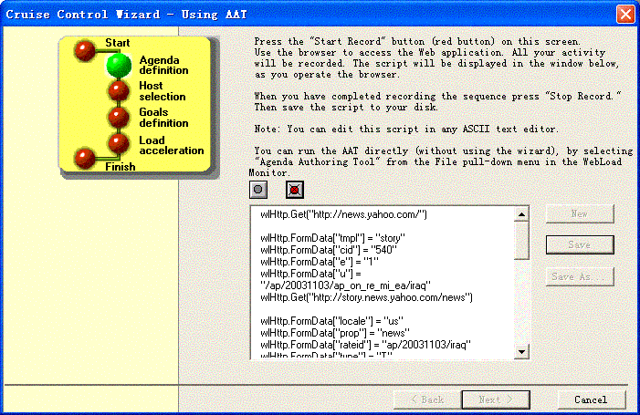
WebLoad 3.0.1

Slide 25
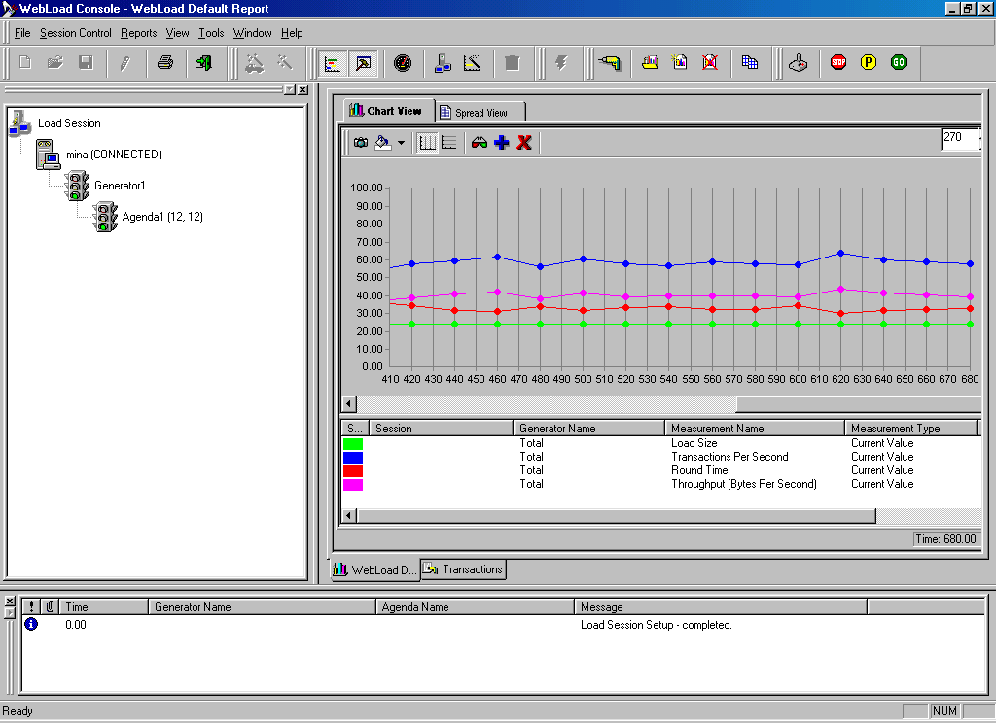
WebLoad Default Report

Slide 26
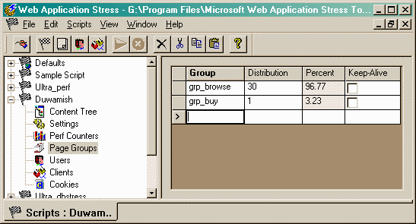
WAS (Web Application Stress)

Slide 27
Test Tools - JMeter
Why JMeter (http://jakarta.apache.org/)?
  1. It is free tool
  2. It is open source
  3. Its basic function is powerful
  4. It is easy to use and program
  5. 3-rd part support from BadBoy (Recorder) tool

Slide 28
Test Tools - JMeter
Basic Elements:
Test Plan
Thread Group
Logic Controller
Sampler
Loop Controller
Listener
Timer
Config Element
Post Processors
Pre Processors

Slide 29
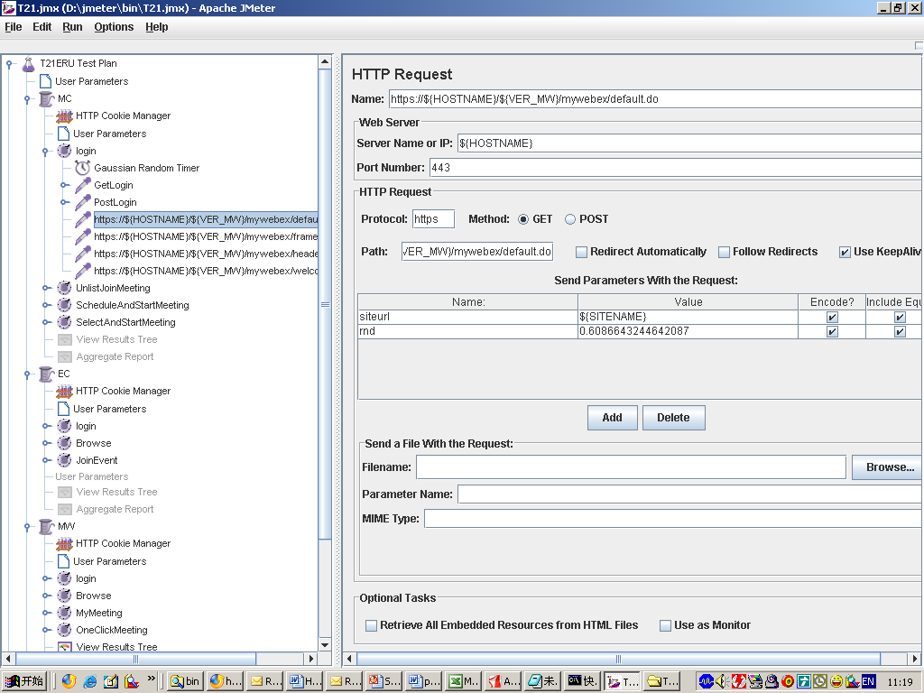
Test Tools - JMeter

Slide 30
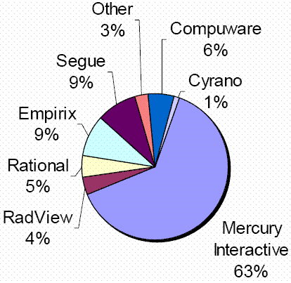
Test Tools Market Share (Newport Group, Inc)

Slide 31
Load Testing Tools (From Abraham Jacob)
Microsoft's web application stress tool | 0
Cyrona's OpenSTA | 1
Quest Software's benchmark factory | 4
Empirix's E-Test Suite 6.0 | 6
RadView's WebLoad 5.0 | 7
Rational Software's Rational Robot | 7
Mercury Interactive's Astra LoadTest 5.4 | 8
Compuware's QA Load 4.7 | 10
Segue Software's SilkPerformer 5.0 | 10+
Best

Slide 32
Test Tools - Comparison
 | Advantages | Disadvantages
WebLoad | 1. easy to learn 2. can generate proper report 3. can record the test script automatically | 1. License is not free 2. could not capture program error effectively
Robot VU | 1. can generate sophisticated report 2. can use C or Java to write the test script | 1. license is not free 2. very hard to analysis the test result 3. the longer learning curve
JMeter | 1. License free/open source 2. Can use third-party software to record the test script. 3. can check the every request and response pair more in detail | 1. Could not generate sophisticated report 2. some bugs on itself

Slide 33
Uptime Monitoring Tool
Uptime requests a page from your server every 15 minutes. If the site is unreachable, Uptime sends you email. Uptime will continue checking your site. When it becomes reachable again, Uptime will send you one more message

Slide 34
Server Uptime Monitoring Tool
It doesn't really matter how good your site is if people can't rely on its being there.
  <Philip Greenspun>
Uptime is a simple free tool that will monitor your web site's visibility on the web and send a message each time your site can't be seen and again when it becomes visible again
This is to know how reliable is your ISP

Slide 35
Exercise
Software Testing, Page 227: 3, 4, 5
  Why is gray-box testing possible with website testing?
  Why can't you rely on a spell checker to check the spelling on a web page?
  Name a few areas that you need to consider when performing configuration and compatibility testing of a website

